Slide 1

OLYMPIC DATA ANALYSIS & PREDECTIONS
Subject: Data 606(Capstone Project)
Professor: Chaojie Wang
Presentor: Ranga Swamy Reddy Kappeta

Slide 2
AGENDA
01. Introduction
02. Data
03. Data Encoding
Introduction to the project
Data cleaning , Data Visualizations are done
Data is classified into simpler terms for model training
04. Modeling
05. Prediction
06. Web Page
Data is split and trained with the models
Suitable model is considered and predicted
Creating web page by using Streamlit

Slide 3
Introduction
Analyzing data relating to the Olympic Games is part of database likely contains data on individuals, events, nations, and medals earned during different Olympic Games editions.
Medal Tally
Overall Analysis
Country wise
Athletes Analysis

Slide 4
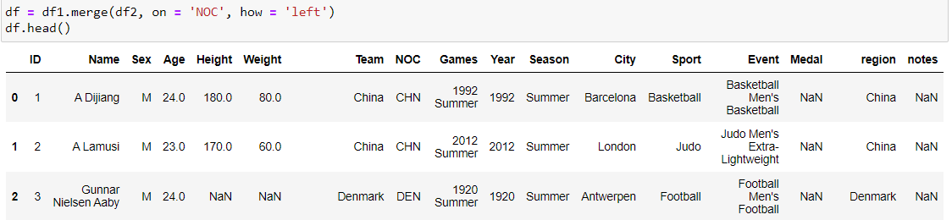
Dataset
This data is referred from Kaggle
https://www.kaggle.com/datasets/heesoo37/120-years-of-olympic-history-athletes-and-results
Data Size(39.5mb)
Data shape (271116 rows x15 colums , 230 rows x 3 columns)

Slide 5
Data Cleaning process
Identify missing values and decide how to handle them. Options include removing rows, filling in missing values, or using advanced imputation techniques.
Using simple visuals to represent key steps like Inspection, Handling Missing Data, Dealing with Duplicates, Addressing Inconsistent Data, Handling Outliers, Standardizing and Normalizing, Text Cleaning, Consistent Naming Conventions, Data Validation.

Slide 6
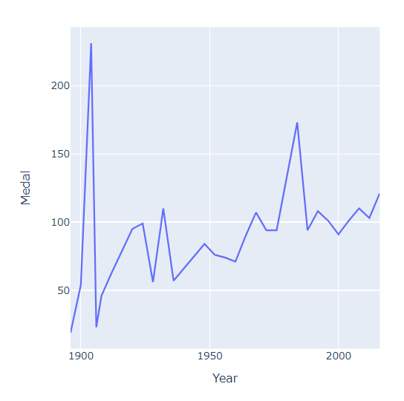
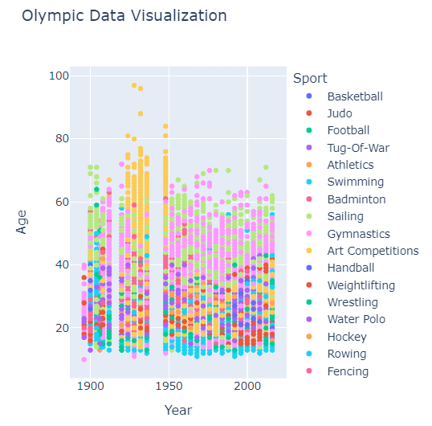
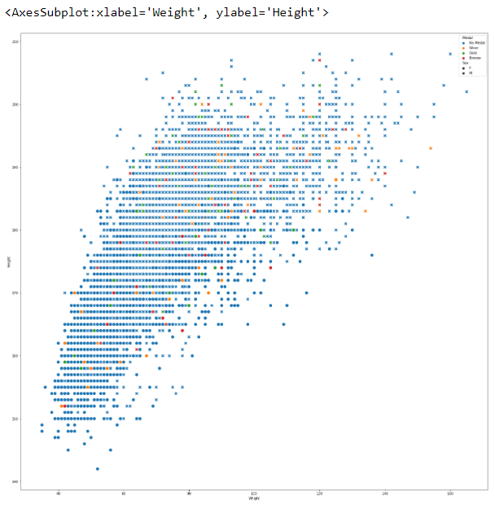
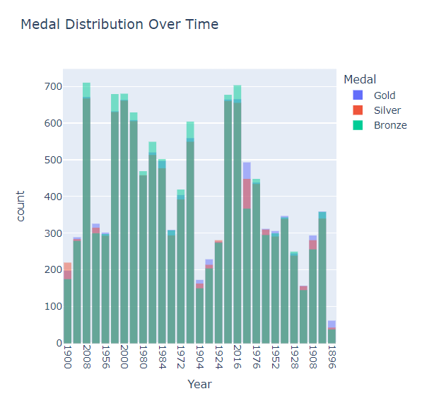
Data Visualization

Slide 7
Data Encoding
When dealing with categorical variables like "Sex" or "Team," encoding is often applied to convert these non-numeric values into a format that machine learning algorithms can understand
One-hot encoding for sex creating binary columns for each sex M could be encoded as 0 and F as 1.
It allows you to represent categorical information in a way that maintains the integrity of the data for analysis and model training.

Slide 8
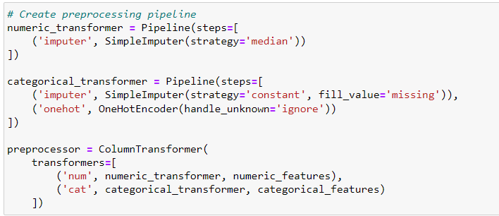
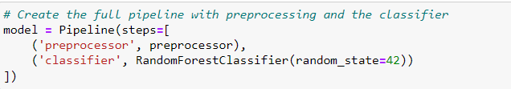
Modeling & Evaluation
Data Splitting into training and testing sets to train the model on one subset and evaluate its performance on another.
To predict and use the actual accuracy I used 5 models.
To find the Accuracy, Precision, F1 Score by using machine learning models.
Using a pipeline in machine learning streamlines and simplifies the process of model training and evaluation. By chaining together multiple data processing steps into a single workflow, it not only makes the process more manageable but also reduces the risk of errors.

Slide 9
Modeling & Evaluation
RandomForest
LogisticRegression
DecisionTreeClassifier
Support Vector Classifier (SVC)
KNeighbors (K-Nearest Neighbors)

Slide 10
Model Accuracy
 | MODEL | Accuracy
01 | Random Forest | 0.34066901408450706
02 | Logistic Regression | 0.3488849765258216
03 | Decision Tree | 0.352406103286385
04 | SVC | 0.3444835680751174
05 | KNeighbors (KNN) | 0.3559272300469484

Slide 11
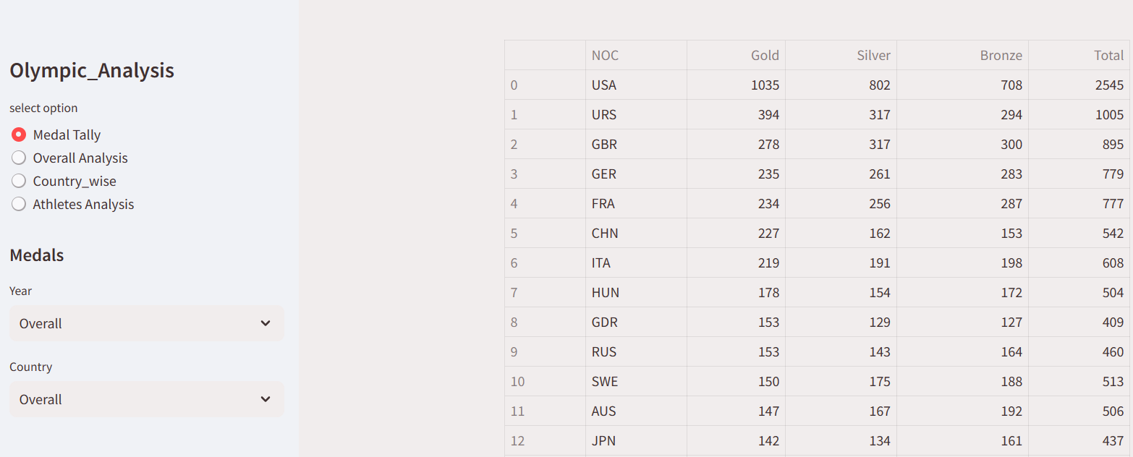
Web Page

Slide 12
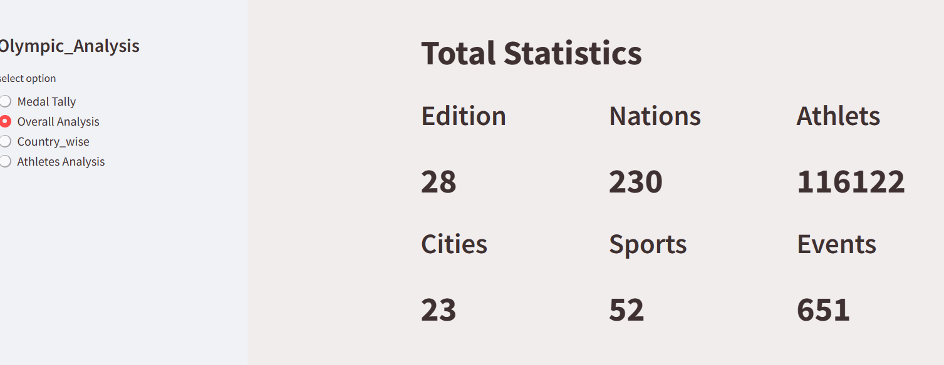
Web Page

Slide 13
Conclusion
In conclusion, the analysis of the Olympic dataset has offered a comprehensive understanding of the dynamics within the world of sports and competitions. Through thorough data exploration and cleaning, we ensured the reliability of our insights. Visualization played a crucial role in presenting trends, relationships, and distributions effectively.
Overall, this analysis encapsulates the essence of Olympic data, combining statistical with insightful visualizations. It serves as a foundation for deeper inquiries and continued exploration into the rich tapestry of Olympic history and achievements.

